Slide 1

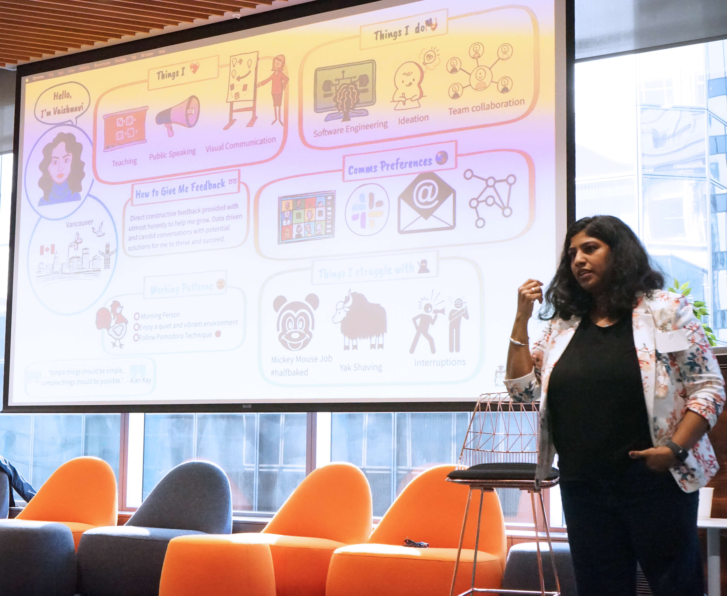
Integrating visual communication and storytelling in Software Engineering
LA
Vaishnavi V

Slide 2
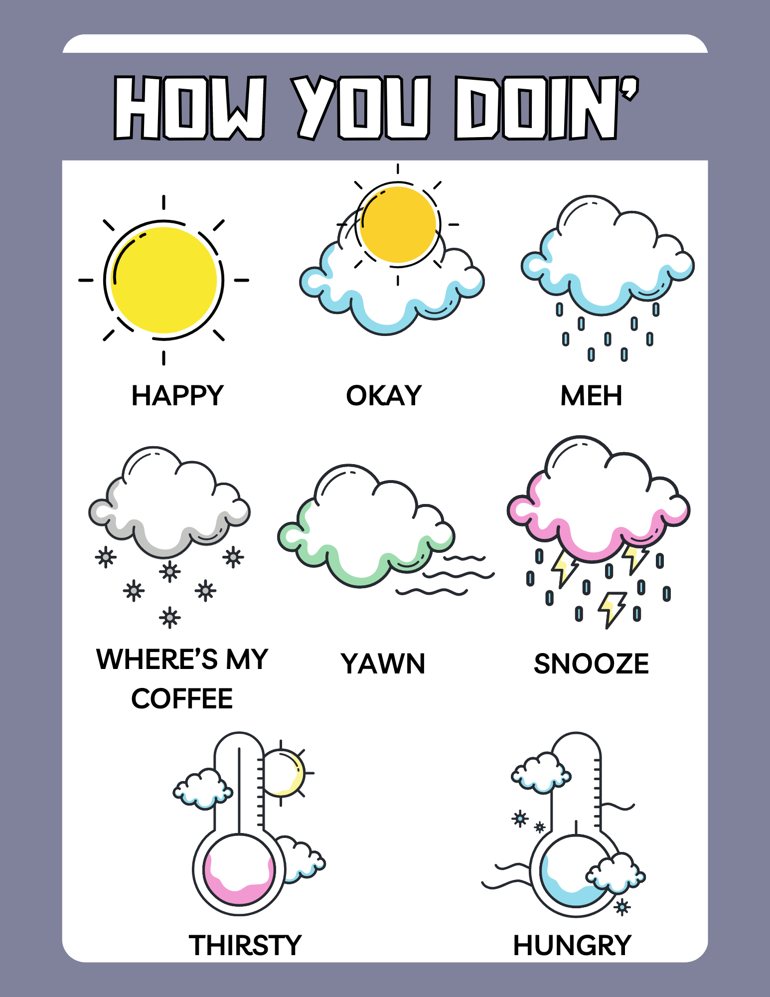

Slide 3


Disclaimer

Slide 4
Presentation is auto biographical – Sample size of 1 No spandex required!

Slide 5
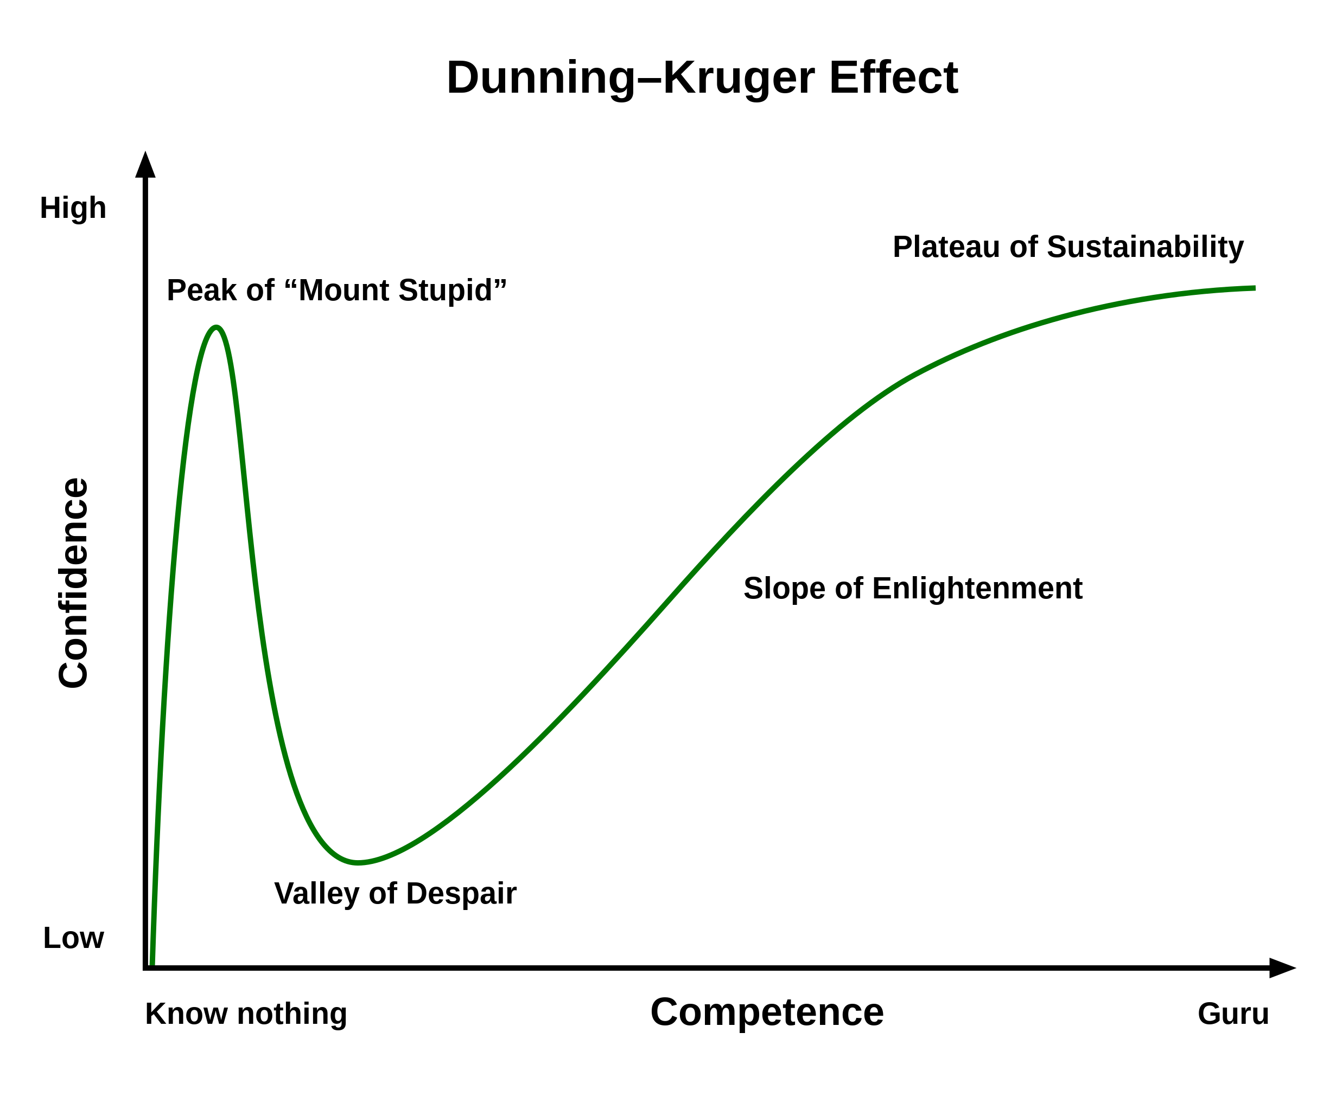

Slide 6
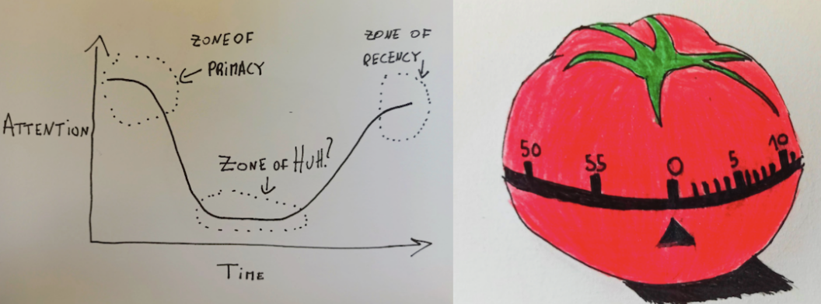
Attention Span
Source : https://semaphoreci.com/blog/storytelling-programming
Notes:
When we perform a task, like learning for an exam, our level of attention varies:
Zone of Primacy: our attention level is high (first 20 minutes)
Zone of Huh: our attention level is low (unlimited)
Zone of Recency: our attention level is high again (last 5 minutes)

Slide 7
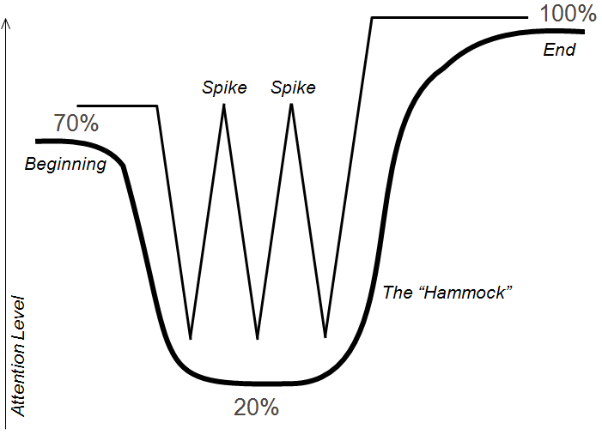
Human attention : The Hammock and the Spikes
Source : Keeping the Audience Engaged with Presentation “Spikes”
Notes:
When we perform a task, like learning for an exam, our level of attention varies:
Zone of Primacy: our attention level is high (first 20 minutes)
Zone of Huh: our attention level is low (unlimited)
Zone of Recency: our attention level is high again (last 5 minutes)

Slide 8
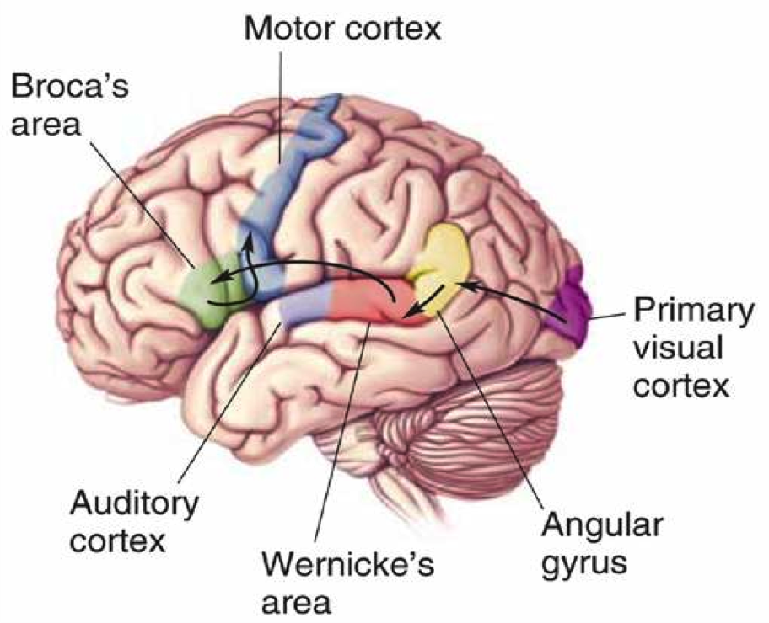
Visual information vs reading words
Notes:
The part of the brain that processes visual information (the visual cortex) is much larger than the part of the brain responsible for reading words (the broca). By providing your information in a visual presentation, you make it much easier on your team to process the information effectively.

Slide 9
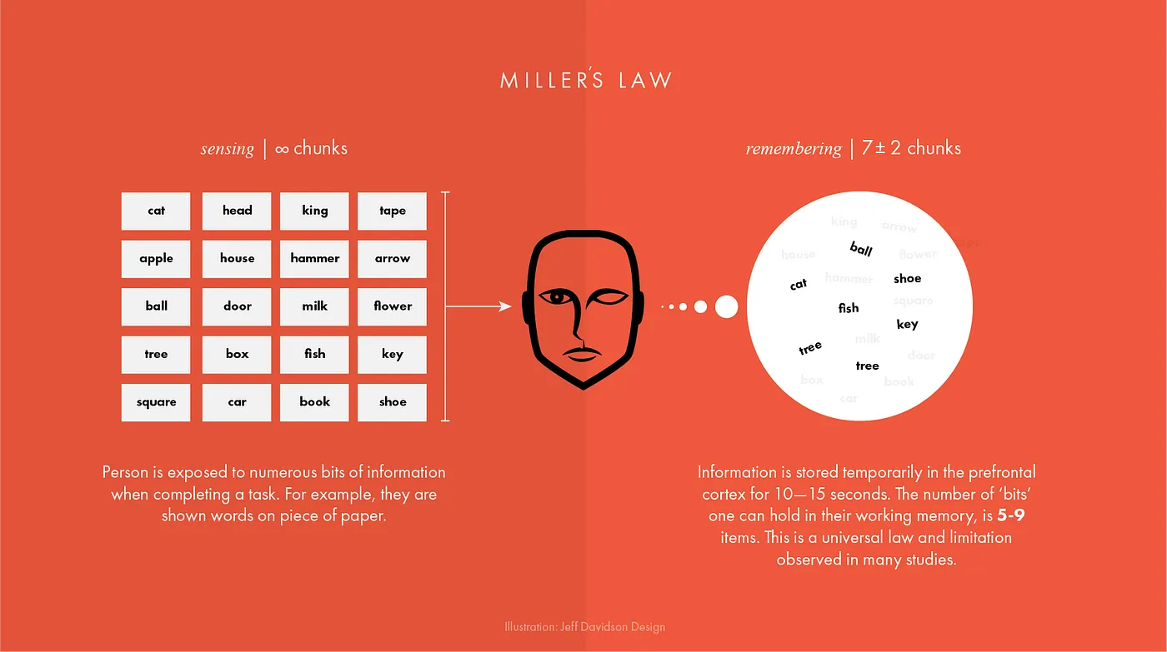
Unique
Tested
Telling stories through visuals and data
Elephant
Authentic
Harnessing color to illustrate importance and attract attention
Creating more memorable information through the use of symbols and icons
Notes:
The first concept is "chunking" and the capacity of short term memory. Miller (1956) presented the idea that short-term memory could only hold 5-9 chunks of information (seven plus or minus two) where a chunk is any meaningful unit. A chunk could refer to digits, words, chess positions, or people's faces. The concept of chunking and the limited capacity of short term memory became a basic element of all subsequent theories of memory.

Slide 10
George Miller’s Magical Number of Immediate Memory
Unique
Tested
Showing the impact of your work by using data visualization
Telling stories through visuals and data
Elephant
Authentic
Creating more memorable information through the use of symbols and icons
Harnessing color to illustrate importance and attract attention
Notes:
Humans are visually oriented animals with approximately 55% of our cortex is dedicated to processing visual stimuli.
The first concept is "chunking" and the capacity of short term memory. Miller (1956) presented the idea that short-term memory could only hold 5-9 chunks of information (seven plus or minus two) where a chunk is any meaningful unit. A chunk could refer to digits, words, chess positions, or people's faces. The concept of chunking and the limited capacity of short term memory became a basic element of all subsequent theories of memory.

Slide 11
Z73. 0

Slide 12
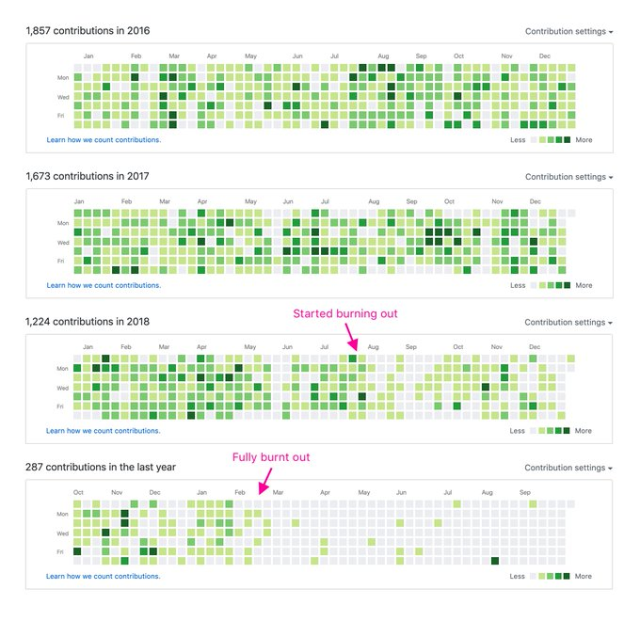
Visualizing burnout
Credits : Jonnie Hallman

Slide 13
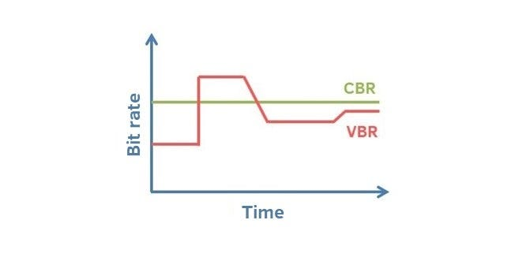
Crest and trough

Slide 14
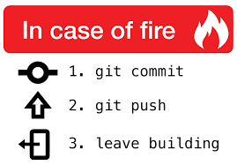
Tell, Don’t Ask
“Programs must be written for people to read, and only incidentally for machines to execute” (SICP)*
Structure and Interpretation of Computer Programs

Slide 15
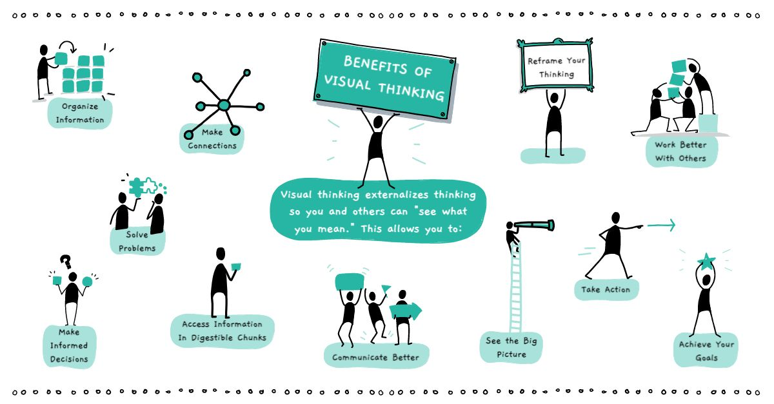

Definition
Visual communication is the practice of using visual elements to get a message across, inspire change, or evoke an emotion.
Source : Drawify

Slide 16
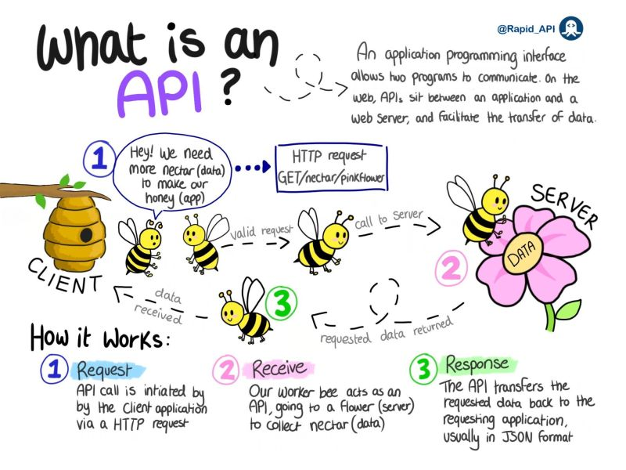
Source :
Notes:
Personal Identifiable Information (PII) is defined as: Any representation of information that permits the identity of an individual to whom the information applies to be reasonably inferred by either direct or indirect means.

Slide 17
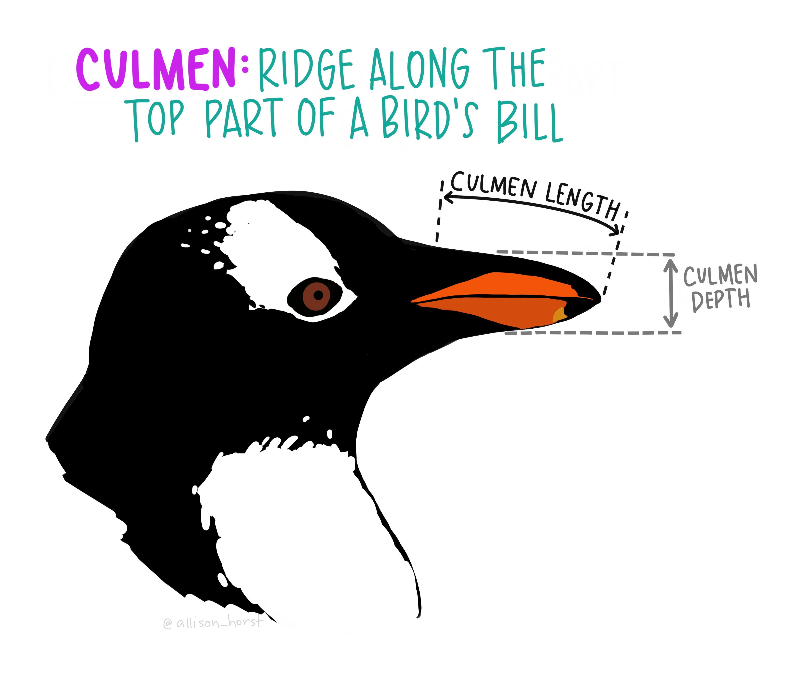
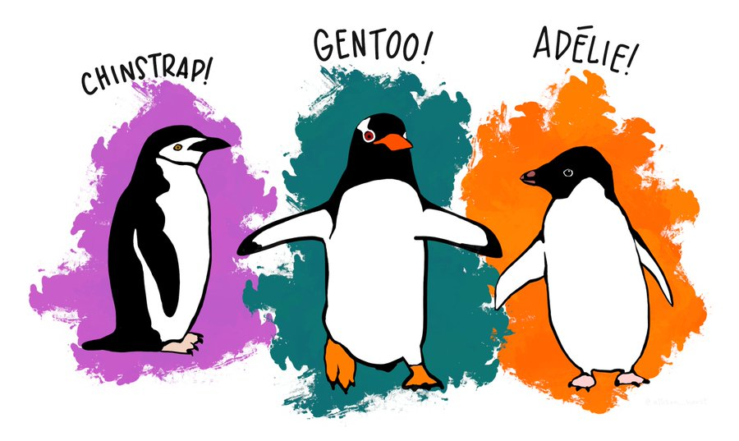
Penguin Dataset
Goal
Determine the species of a penguin
Parameters :
• Culmen length
• Culmen depth
• Flipper length
• Body mass
Source : Twitter

Slide 18

Manual Of Me

Slide 19


Slide 20
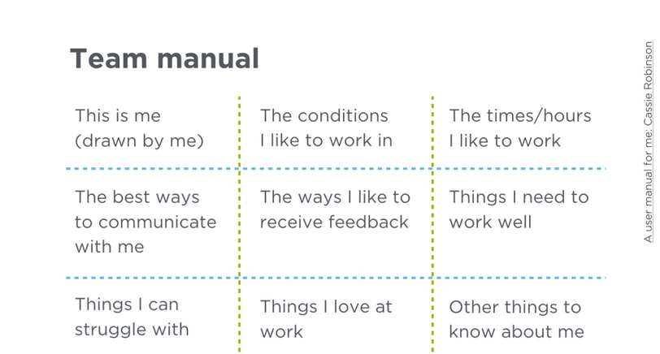

Slide 21
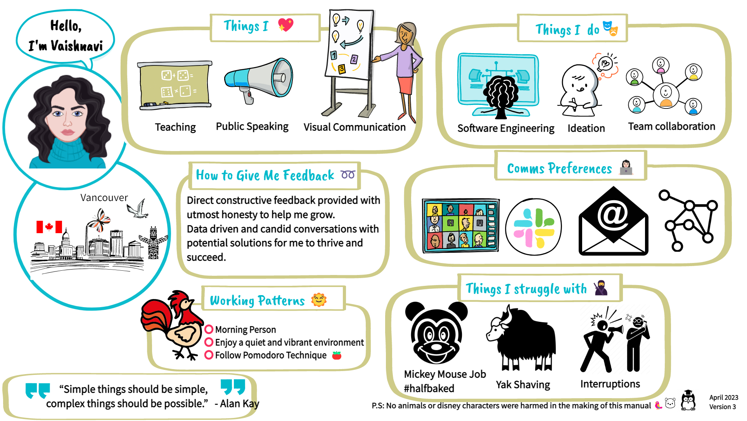

Slide 22
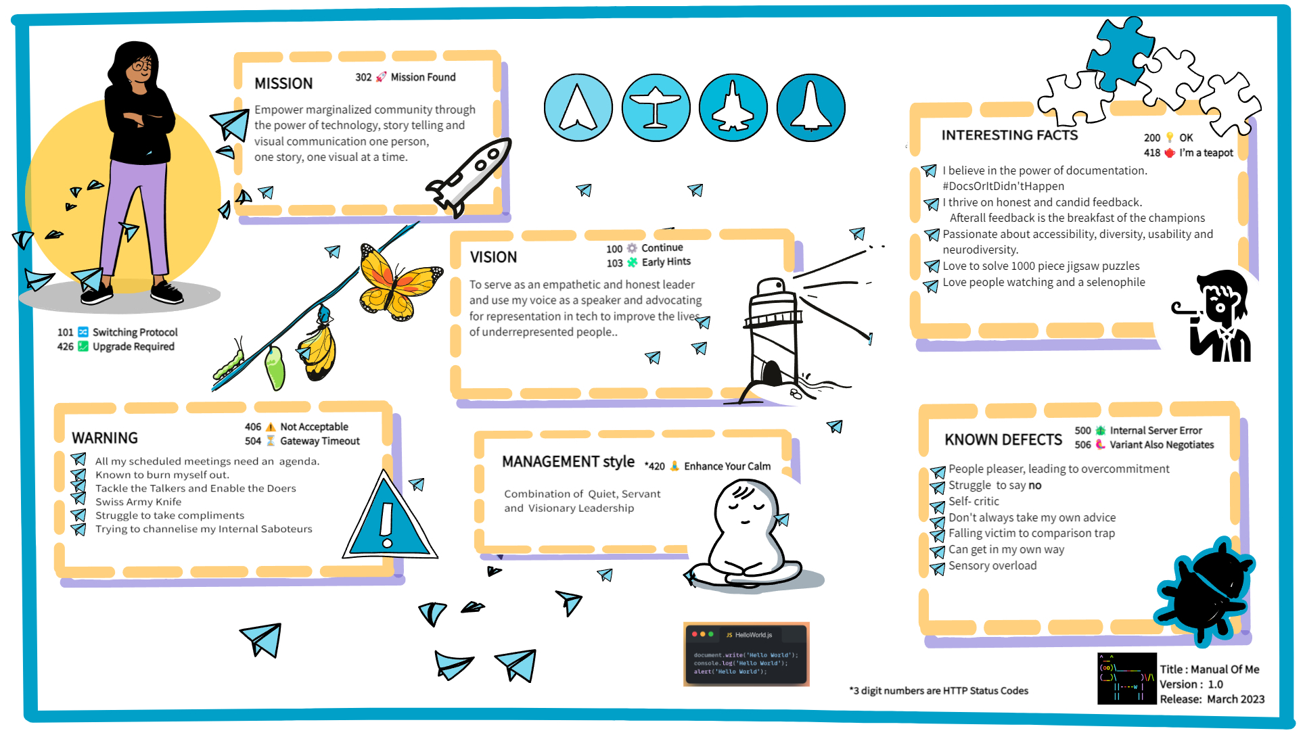
Meet the team

Slide 23
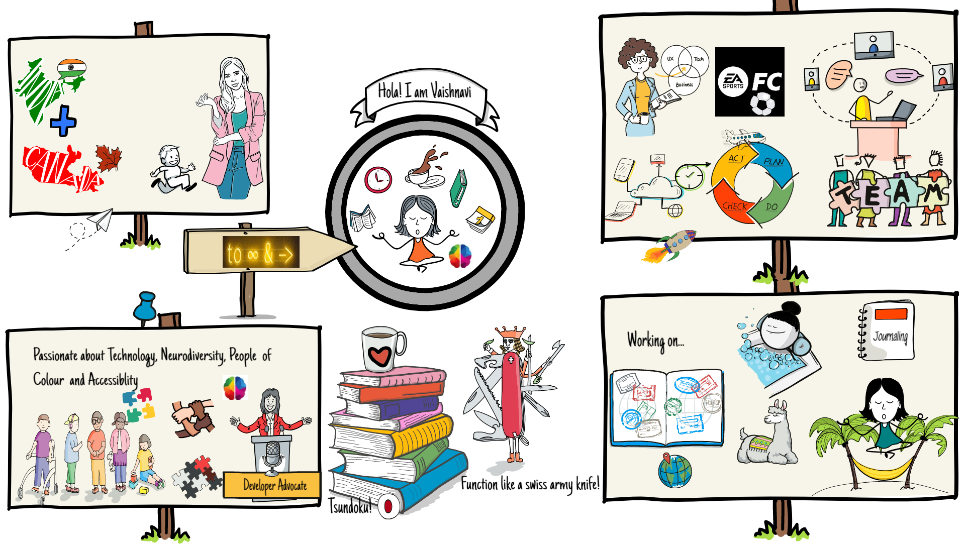
Meet the team

Slide 24
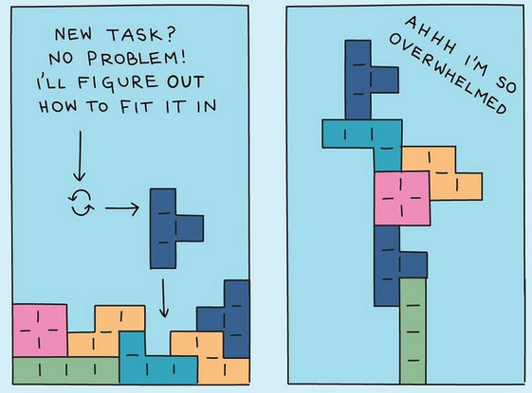
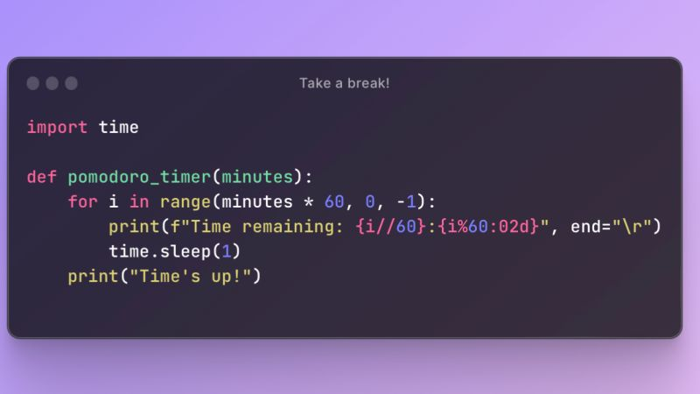

Ideas
$3B
$2B
$ 1B
Opportunity to build
Fully inclusive market
Total addressable market
Freedom to invent
Selectively inclusive market
Serviceable available market
Few competitors
Specifically targeted market
Serviceable obtainable market

Slide 25
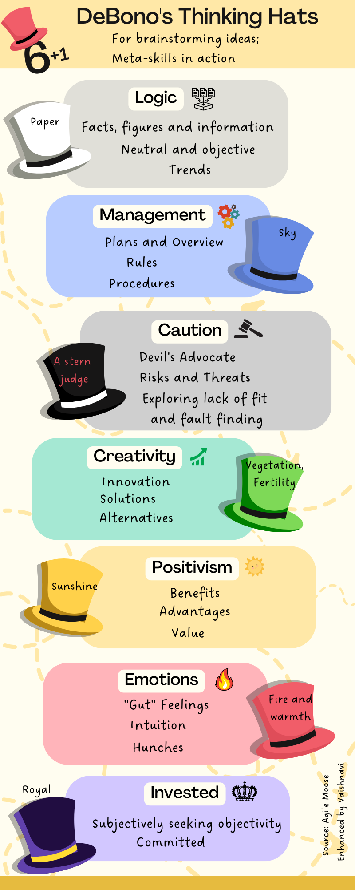

Slide 26
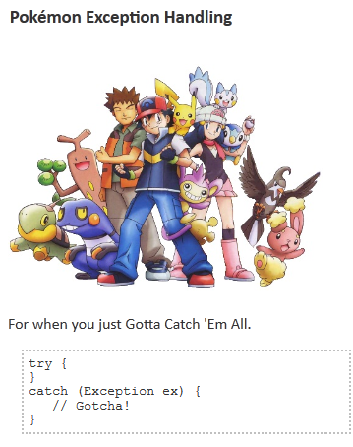



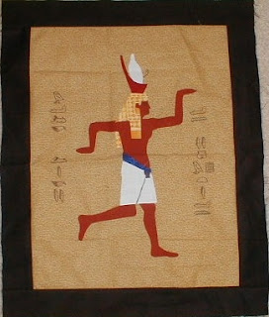

Programmer Jargon

Slide 27
Precaution

Slide 28

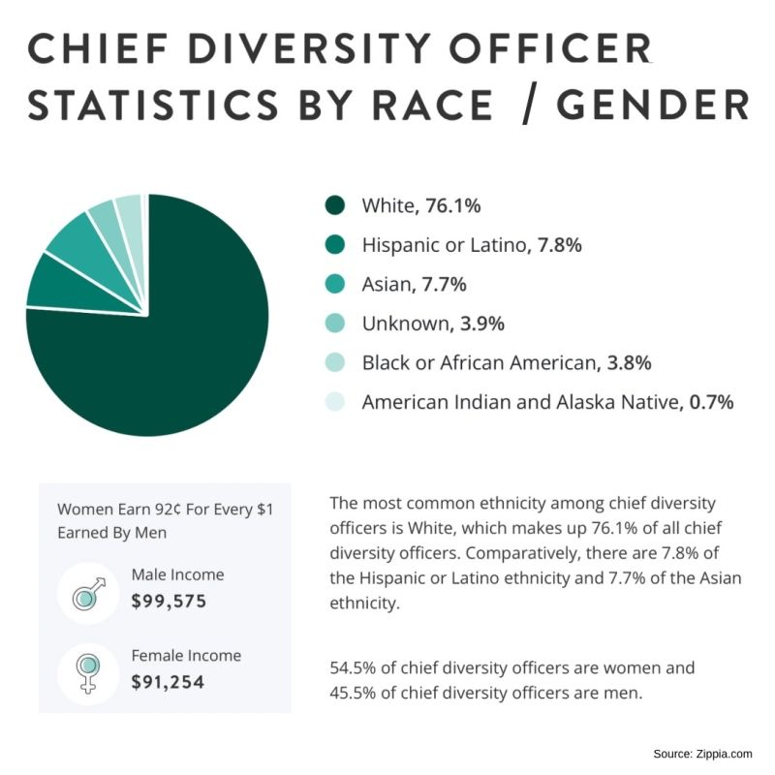
Overwhelming the user!

Slide 29

Clutter
Copyright: .marqs / photocase.com

Slide 30

Colors alone
Inaccessible
Red-green color blind?
Course # | Name
Algo 101 | Introduction to Algorithms
Networking 101 | Topology and Networking
Gardening 101 | Soil therapy for beginners

Slide 31
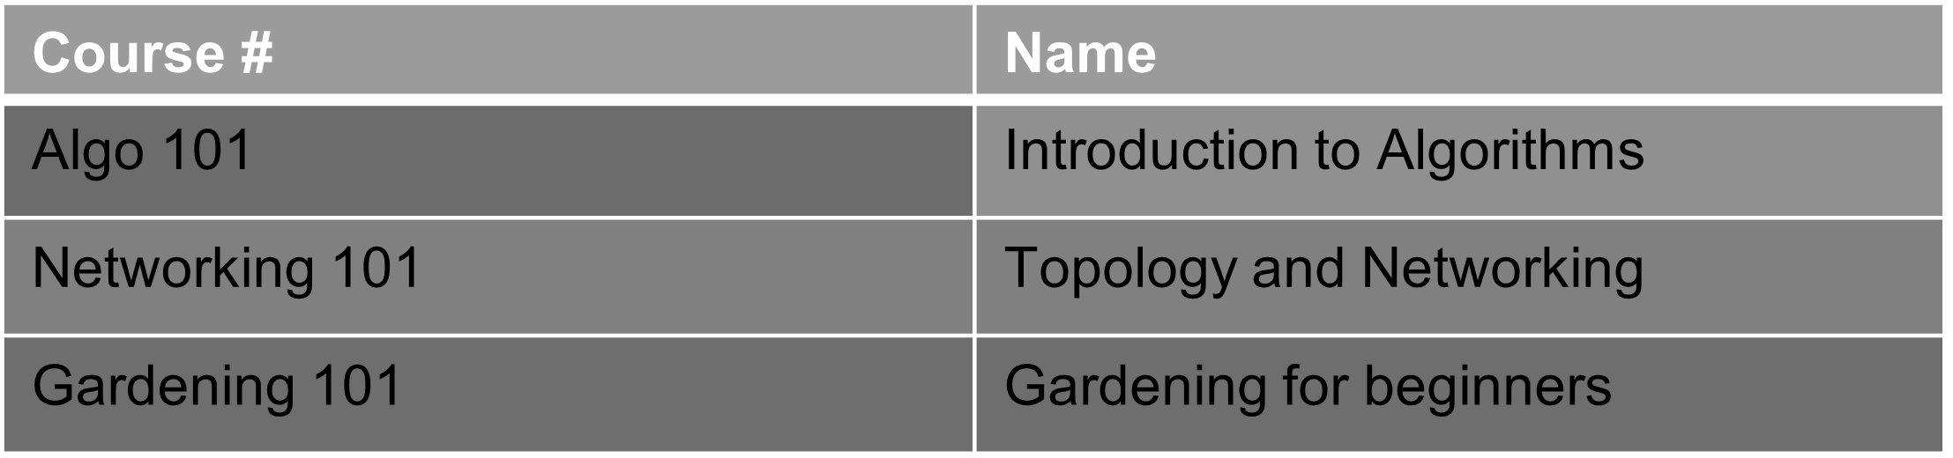
Colors alone!

Slide 32

Alternate means of communication
Accessible Example
Course # | Name | Required
Algo 101 | Introduction to Algorithms | Yes
Networking 101 | Topology and Networking | No
Gardening 101 | Gardening for beginners | No

Slide 33


Misinterpretation or reading between the lines?

Slide 34
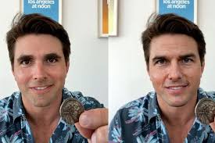
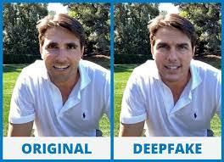
Deepfake technology: seeing is believing, or is it?

Slide 35
“Don’t tell me the moon is shining. Show me the glint of light on broken glass.”
- Anton Checkhov
Notes:
“Don’t tell me the moon is shining. Show me the glint of light on broken glass.” - Anton Checkhov

Slide 36



